Slide 1
Free Public Transport: Causal Analysis of Tourists’ Travel Mode Choice
CE6511 Transportation Planning
Paper Presentation
Kevin Blättler, Hannes Wallimann, Widar von Arx
Presented by
Nafim Shahriyar Hossain
StID: 0424042401

Slide 2
Section Overview
1
Introduction
2
Objective of Work
3
Data Collection
4
Methodology
5
7
Conclusion
Praise & Critique of the Paper
Results
6

Slide 3
Introduction
Problem Statement
Transportation by car for tourism contributes 5.5% global CO₂ emission
Policies incentivizing public transport use underexplored
Research Methodology
Employing Natural Experiment and Causal Inference Methods (Propensity Score Matching and Causal Forests)
Significance
Provides empirical evidence on effectiveness of Fare-free Public Transport (FFPT)

Slide 4
Objective of the Work
Transportation Context
Private car in tourism – largest domestic contributor of CO₂ emissions
Shifting to Public Transport to reduce emission
Align with Sustainable Mobility Goals
Research Goal
Quantifying effect of FFPT policies on shift from private car
Evaluating behavioral changes and policy implications

Slide 5
Data Collection
Source of Data
Primary Dataset: Survey conducted in Appenzell Innerrhoden, Switzerland
Survey Details
Target Group: Tourists staying 3+ nights, eligible for FFPT offer
Collection Method: Flyers, Email invitations, QR Codes
Timeframe: May-October 2023

Slide 6
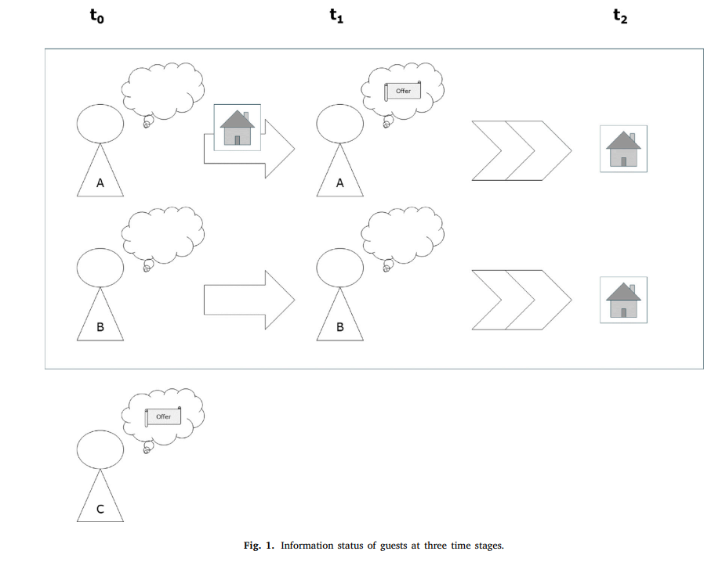
Data Collection
Treatment Group
(A)
Control Group
(B)
Ignored Group
(C)

Slide 7
Data Collection Continued…
Sample Characteristics
Initial Responses: 1871
Final Dataset: 843 after post-cleaning
Key Variables
Dependent Variables: Mode Choice (PT = 1, Private Car = 0)
Independent Variables: Accommodation Type, Trip Length, Travel Distance, Demographics (age, income etc.)

Slide 8
Methodology
Objective
Estimate causal effect of FFPT information on mode choice
Analyze subgroup-specific variations in treatment effects
Methods used
Propensity Score Matching (PSM)
Causal Forests (CF)

Slide 9
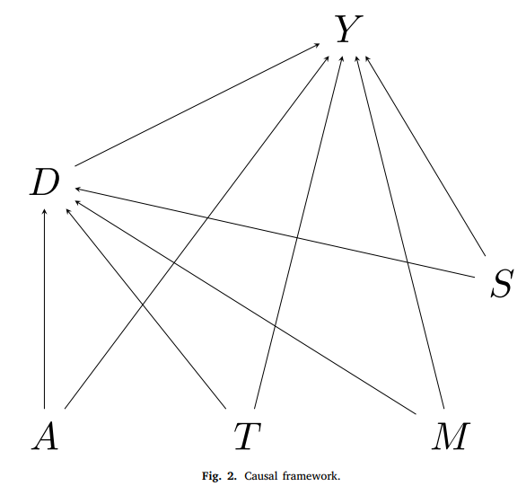
Methodology
Causal Framework
Accommodation Specific Characteristics (A)
Hotel-specific ratio of informed vs uninformed guests
Accommodation type (hotel vs holiday flat)
Accessibility by train or other modes
Trip-related Characteristics (T)
Travel Party Composition (alone, with family etc.)
Purpose of travel
Travel time difference between car and PT
Length of stay
Mobility Tools (M)
Ownership of Car
Ownership of PT season tickets

Slide 10
Methodology
Causal Framework
Socio-demographic Characteristics (S)
Age
Gender
Income Level
Treatment Indicator (D)
Binary variable indicating whether a tourist was informed about the FFPT offer or not
D = 1 when informed
D = 0 when not informed
Outcome Variable (Y)
Binary variable indicating travel mode choice of the tourist
Y = 1 when PT used
Y = 0 when PT not used

Slide 11
Methodology Continued…
Propensity Score Matching (PSM)
Matches informed (treatment) and uninformed (control) tourists based on similar characteristics
Reduces bias from observable factors (accommodation type, demographics, travel distance)
Steps:
Calculate probability of receiving treatment (Propensity score = 1) based on covariates
Match individuals with similar scores from both groups for comparability

Slide 12
Methodology Continued…
Propensity Score Matching (PSM)
Steps:
Estimate Average Treatment Effect (ATE) by measuring difference in outcome (PT usage) between matched treatment and control groups
ATE represents overall impact of FFPT on mode choice
Provides robust ATE estimates by limiting analysis to matched pairs

Slide 13
Methodology Continued…
Causal Forests (CF)
Machine learning approach for estimating heterogeneous treatment effects
Outputs Conditional Average Treatment Effects (CATE) for different subgroups
CATE shows the variation in treatment effect by tourist characteristics (travel distance, accommodation type etc.)
Builds multiple decision trees to identify subgroups with similar covariates
Captures non-linear relationships and complex interactions between covariates
Provides a detailed understanding of subgroup specific responses

Slide 14
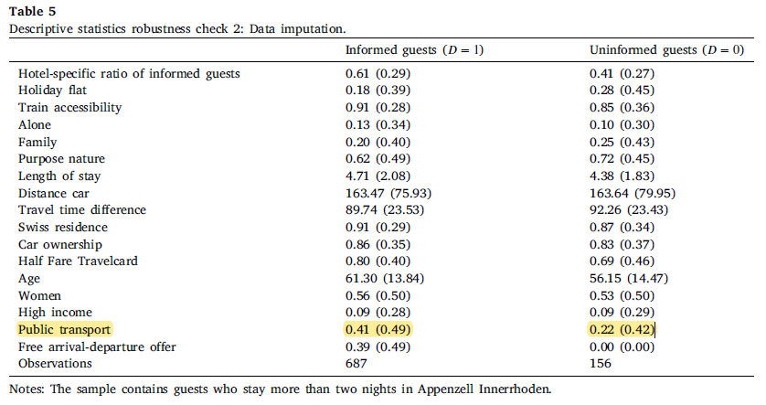
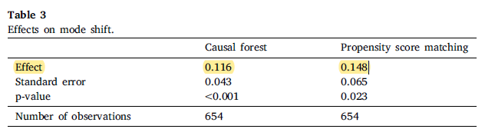
Results Table
Table 1
Table 2

Slide 15
Results Summary
Modal Shift
Increase in PT usage: 11.6% - 14.8% (ATE estimates)
44% of informed guests used PT
22% of uninformed guests used PT
Environmental Impact
57.2 kg CO₂ savings per trip per person
3.6% annual reduction in Switzerland’s domestic CO₂ emission
Heterogeneous Effect
Stronger Shift: Tourist travelling shorter distances or staying in train-accessible accommodations
Weaker Shift: Family Travelers

Slide 16
Praise of the Paper
Robust Methodology
Propensity Score Matching & Causal Forests
Focus on Average Treatment Effect (ATE) & Conditional ATE (CATE) to treat heterogeneity across groups
Robustness checks to strengthen validity of results
Transparent and reproducible in similar studies
Policy-Relevant Results
Clear, Actionable insights for policymakers
Environmental & Behavioral Impact
Reduce Emission
Sustainable Travel

Slide 17
Critique of the Paper
External Validity
Switzerland – highly efficient and integrated PT system
May not generalize to regions with low PT quality or accessibility
International tourists may prefer private vehicles
Long-term Behavioral Insights
Snapshot of Travel Mode Choice
Improvement by conducting longitudinal studies
Limited Consideration of Constraints
Luggage constraints for families
Accessibility challenges for older tourists
Improvement by luggage services, shuttle connections etc.

Slide 18
Conclusion
FFPT policies influence tourists’ modal choices, reducing private car usage and emissions
Robust causal analysis confirms policy’s effectiveness in sustainable tourism
Encourage adoption in high-quality PT System
Pair FFPT policies with pricing interventions for maximum impact

Slide 19
The End
Thank You!

